Slide 1
Data flows -
(Cases & Deaths File)

Slide 2
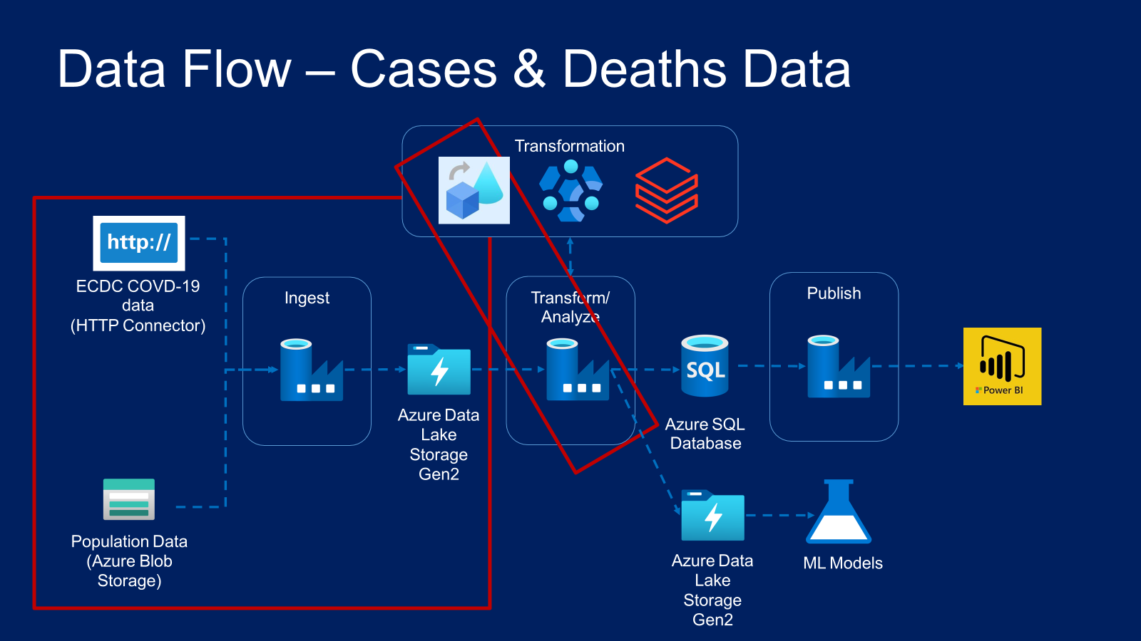

Slide 3
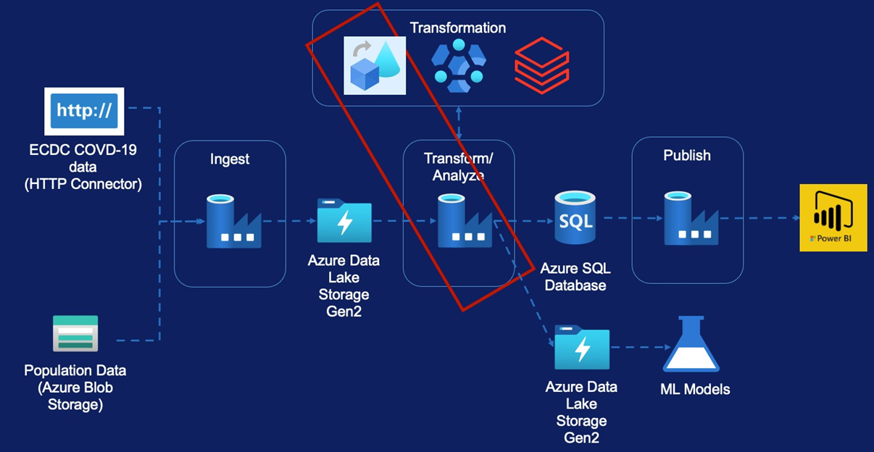
Data Flow- Cases & Deaths Data
Data Flow Overview
Requirement
Source Transformation
Filter Transformation
Select Transformation
Pivot Transformation
Lookup Transformation
Sink Transformation
Create Pipeline

Slide 4
Code free data transformations
Data Flows
Features
Executed on Data Factory managed Databricks Spark clusters
Benefits from Data factory scheduling and monitoring capabilities.

Slide 5
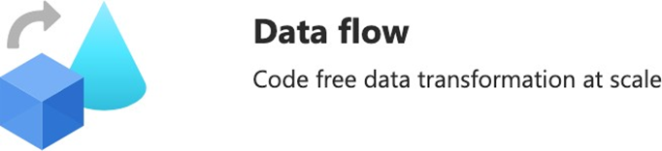
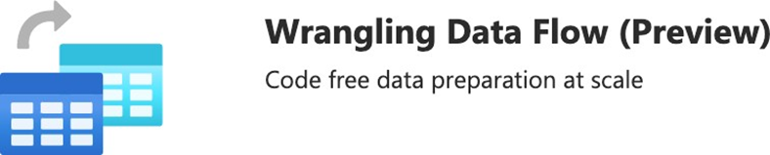
Data Flows
Types

Slide 6
Only available in some regions
https://docs.microsoft.com/en-us/azure/data-factory/concepts-data-flow- overview#available-regions
Limited set of connectors available
https://docs.microsoft.com/en-us/azure/data-factory/data-flow-source#supported- sources
Not suitable for very complex logic
Data Flows
Limitations

Slide 7
Transform Cases & Deaths Data

Slide 8
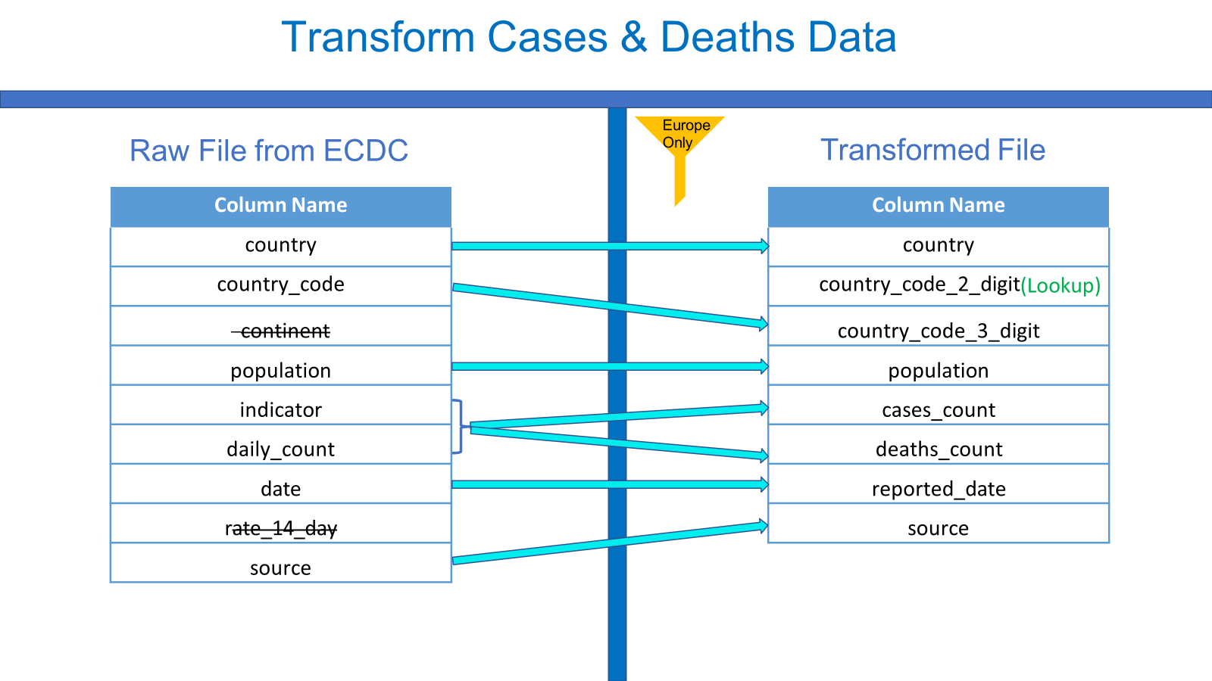

Slide 9
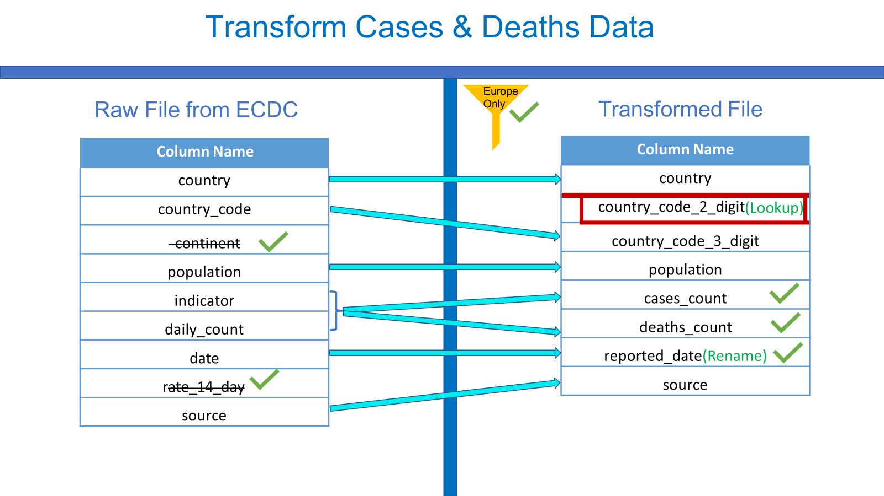

Slide 10
Thank You

